Slide 1
Predictive Model for Customer Product Purchase
Mo Peikari

Slide 2
Aims
Predict potential customer’s propensity to purchase products from bank
Understand important customers’ characteristics driving purchasing behaviour

Slide 3
Methodology overview
Following steps were performed in order to map data to appropriate propensity score:
Data exploration: appropriate sanity checks on data followed by visualizations to ensure quality of data
Data preparation: appropriate data manipulation techniques were used including missing value replacements to prepare data for the modeling stage
Data modeling: multiple machine learning models were tested on data and the best performing one was picked for score generation. Models were validated properly to ensure precision on new production data.
Exploration
Preparation
Modeling
Data sanity checks
Visualization
etc
Data manipulation
Missing value treatment
etc
Machine
Learning
Data
Score

Slide 4
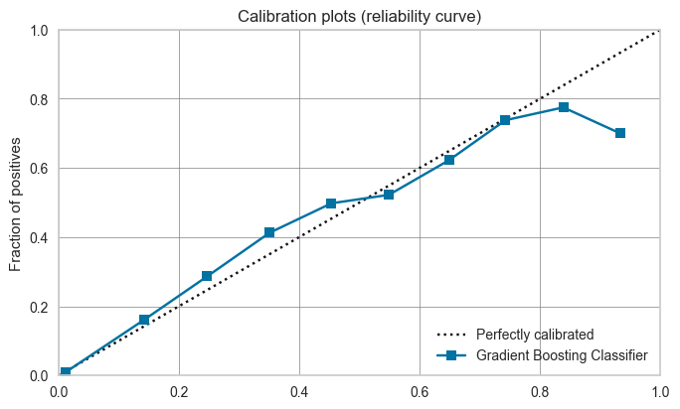
Machine learning solution
Best performing machine learning model was a tree-based technique.
This method essentially works like a complicated multiple if-else statements to divided data into meaningful combinations and eventually turn them into scores.
The machine learning model was properly validated using standard techniques in the field to ensure its accuracy and bias-free performance.
Model was further used to study features that are highly impactful in generating the scores
Recommendations were made based on those highly-relevant features
Calibration plot; showing quality of scoring.
y-axis shows the proportion of true outcomes, and x-axis is the mean predicted probability.

Slide 5
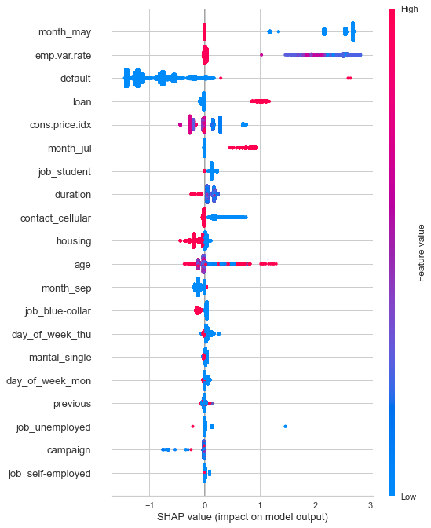
Top predictive features
Figure shows what impact each feature has towards scoring customers. High or low values of each feature impacts the way model scores a customer.
Based the plot, following features are important to consider: month, job, call duration, type of contact, age, has credit in default, has house or personal loans, socio-economic contributions and marital status.

Slide 6
Recommendations
Below are some of the recommendations to increase sales to potential customers:
Time:
Months of May and September are probably not a good time to approach customers while July is the best
Monday and Thursday are not a good time to approach customers
Customers who don’t have house loans and/or have personal loans and/or have not been defaulted on other credits will more-likely purchase a product
Approach those customers whose jobs might make them in need of some of the products like students, self-employed, etc
Try to avoid contacting customers to their cellular phones
Customers at their middle ages are less likely to purchase products while those who are younger or elder will more likely purchase
Duration of calls should be minimized as much as possible and avoid very long calls
Focus more on those customers who have more stable employment rates (emp.var.rate) and those who have lower consumer price index (probably more in need of banking products to boost up their consumption)

